Slide 1
COMP 2230
Week 13 - Monday

Slide 2
Last time
Exam 3 post mortem
Introduction to formal languages

Slide 3
Questions?

Slide 4
Assignment 6

Slide 5
Logical warmup
Imagine three four-sided dice
Each one has a single letter on each side
Rolling the dice yields three random letters which can sometimes be arranged into a word
Rolling the dice has generated these words:
  CAT, SON, POD, RIG, PEG, TAP, DIN, APE
What are the letters on each of the dice?

Slide 6
Back to Formal Languages

Slide 7
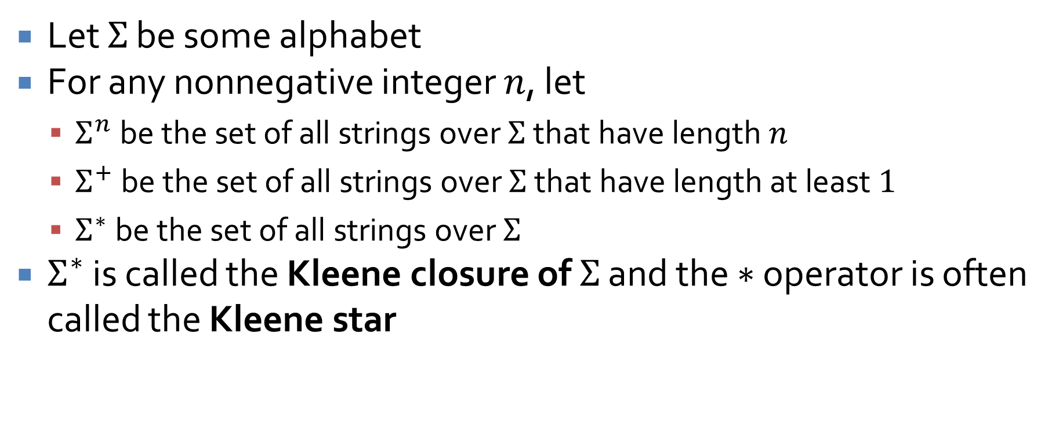
Notation
Let $Σ$ be some alphabet
For any nonnegative integer $n$, let
  $Σ^{n}$ be the set of all strings over $Σ$ that have length $n$
  $Σ^{+}$ be the set of all strings over $Σ$ that have length at least $1$
  $Σ^{∗}$ be the set of all strings over $Σ$
$Σ^{∗}$ is called the Kleene closure of $Σ$ and the $∗$ operator is often called the Kleene star

Slide 8
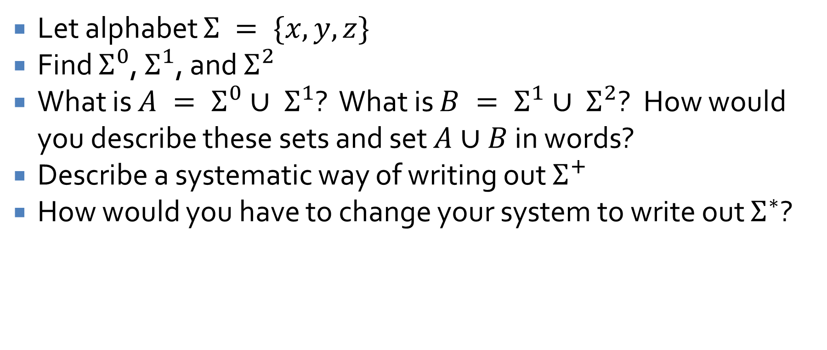
Examples
Let alphabet $Σ = \{x, y, z\}$
Find $Σ^{0}$, $Σ^{1}$, and $Σ^{2}$
What is $A = Σ^{0}∪ Σ^{1}$? What is $B = Σ^{1}∪ Σ^{2}$? How would you describe these sets and set $A∪B$ in words?
Describe a systematic way of writing out $Σ^{+}$
How would you have to change your system to write out $Σ^{∗}$?

Slide 9
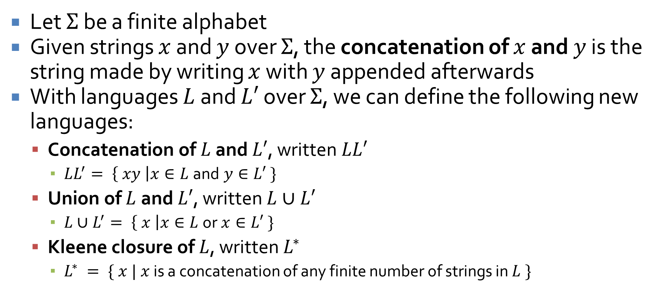
More notation
Let $Σ$ be a finite alphabet
Given strings $x$ and $y$ over $Σ$, the concatenation of $x$ and $y$ is the string made by writing $x$ with $y$ appended afterwards
With languages $L$ and $L′$ over $Σ$, we can define the following new languages:
  Concatenation of $L$ and $L′$, written $LL′$
    $LL^{′}= \left\{ xy \right|x∈L$and$y∈L′ \}$
  Union of $L$ and $L′$, written $L∪L′$
    $L∪L^{′}= \left\{ x \right|x∈L$or$x∈L′ \}$
  Kleene closure of $L$, written $L^{∗}$
    $L^{∗} = \{ x | x$ is a concatenation of any finite number of strings in $L \}$

Slide 10
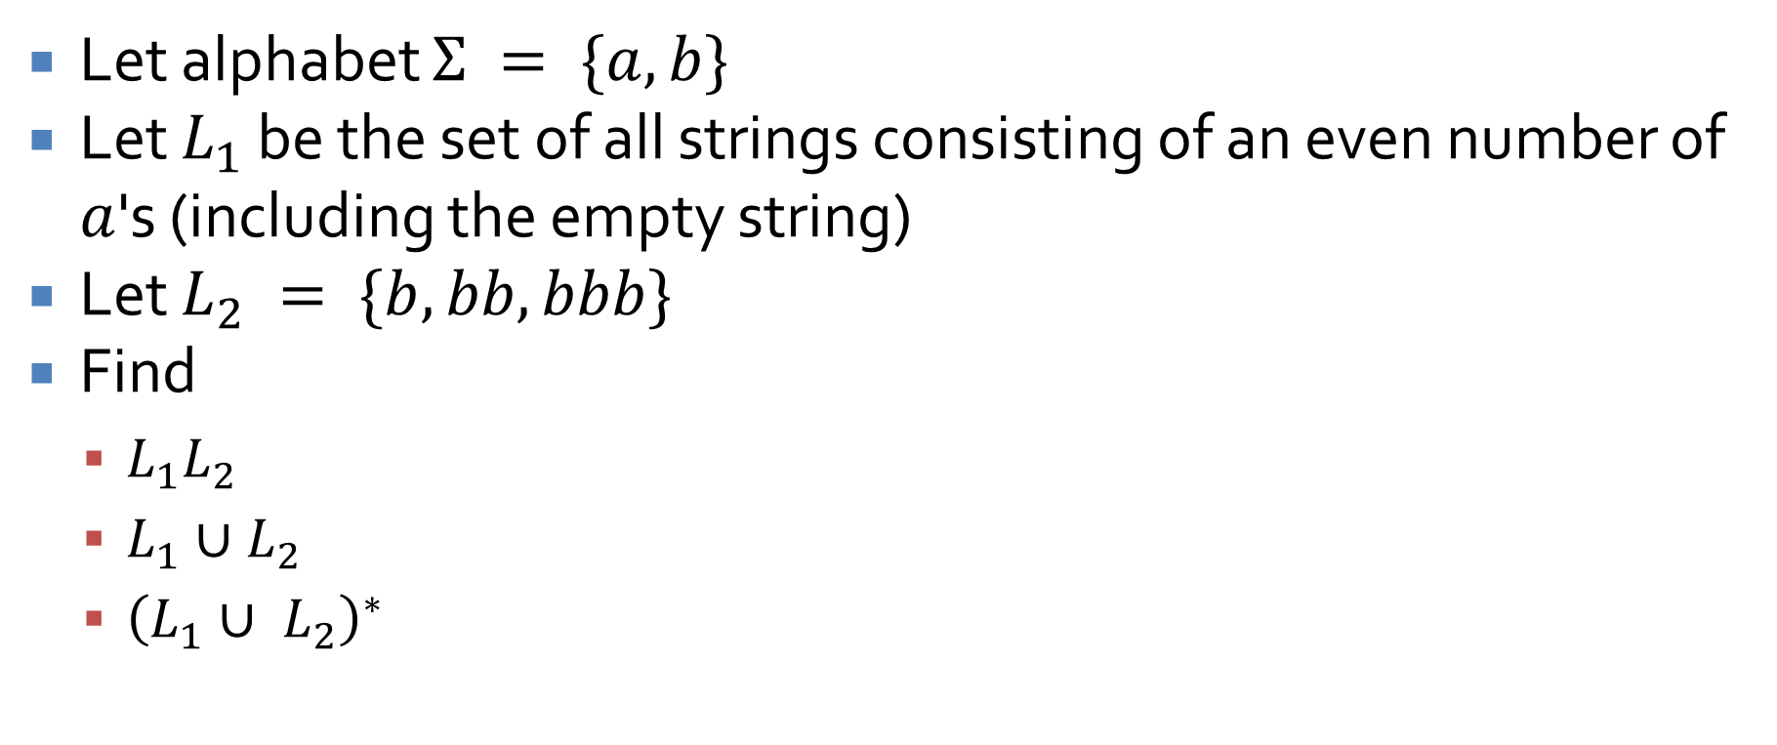
Examples
Let alphabet $Σ = \{a, b\}$
Let $L_{1}$ be the set of all strings consisting of an even number of $a$'s (including the empty string)
Let $L_{2} = \{b, bb, bbb\}$
Find
  $L_{1}L_{2}$
  $L_{1}∪L_{2}$
  ${\left(L_{1}∪ L_{2}\right)}^{∗}$

Slide 11
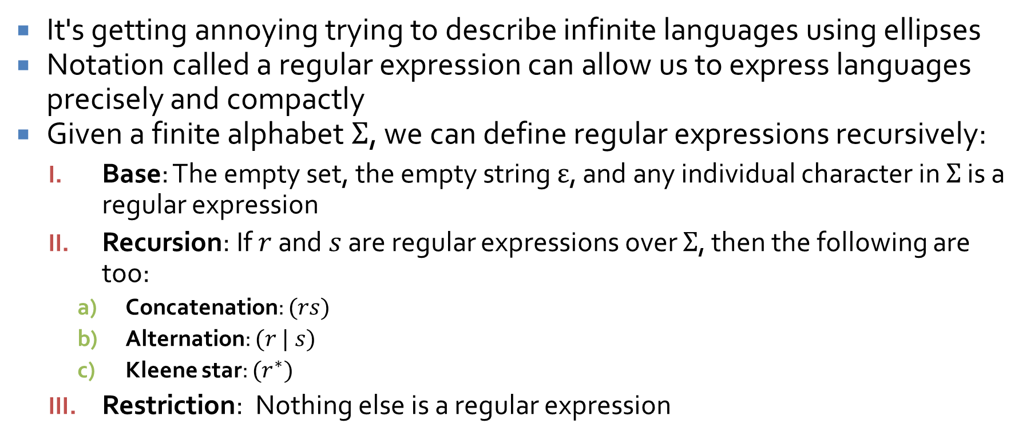
Regular expressions
It's getting annoying trying to describe infinite languages using ellipses
Notation called a regular expression can allow us to express languages precisely and compactly
Given a finite alphabet $Σ$, we can define regular expressions recursively:
  Base: The empty set, the empty string $ε$, and any individual character in $Σ$ is a regular expression
  Recursion: If $r$ and $s$ are regular expressions over $Σ$, then the following are too:
    Concatenation: $(rs)$
    Alternation: $(r | s)$
    Kleene star: $(r^{∗})$
  Restriction: Nothing else is a regular expression

Slide 12
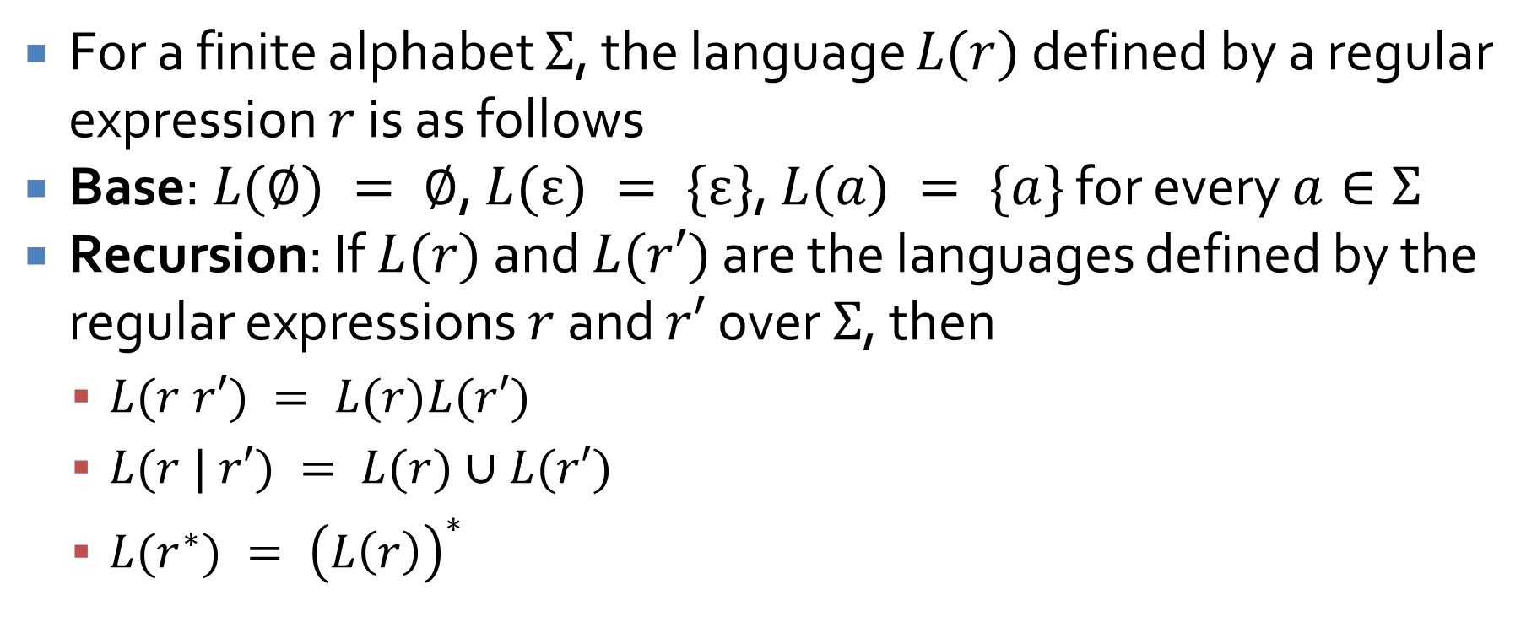
Languages defined by a regular expression
For a finite alphabet $Σ$, the language $L(r)$ defined by a regular expression $r$ is as follows
Base: $L(∅) = ∅$, $L(ε) = \{ε\}$, $L(a) = \{a\}$ for every $a∈Σ$
Recursion: If $L(r)$ and $L(r′)$ are the languages defined by the regular expressions $r$ and $r′$ over $Σ$, then
  $L(r r′) = L(r)L(r′)$
  $L(r | r′) = L(r)∪L(r′)$
  $L(r^{∗}) = {\left(L\left(r\right)\right)}^{∗}$

Slide 13

Examples
Let $Σ = \{a, b, c\}$
Let language $L = a {\left| \left(b \right| c\right)}^{∗} | {\left(ab\right)}^{∗}$
  Write $5$ strings in $L$
Let language $M = ab^{∗}\left(c \right| ε)$
  Write $5$ strings in $M$

Slide 14
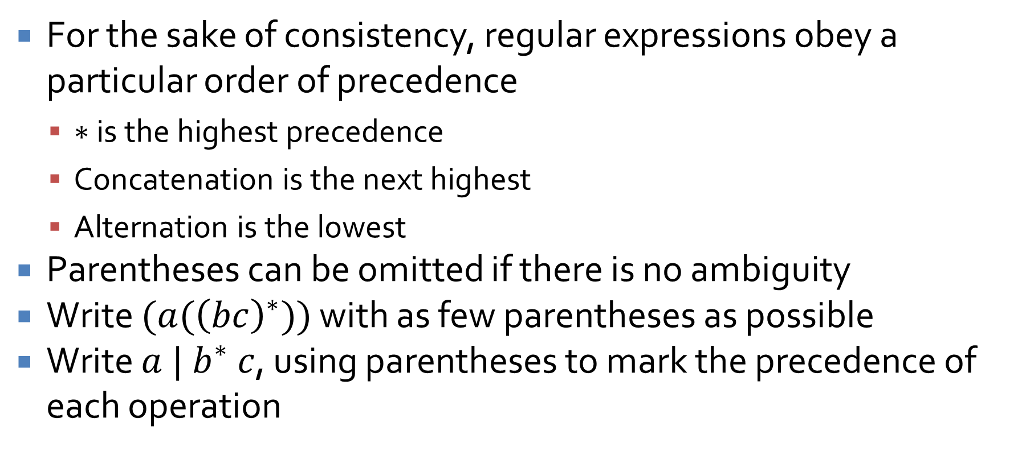
Order of precedence
For the sake of consistency, regular expressions obey a particular order of precedence
  $∗$ is the highest precedence
  Concatenation is the next highest
  Alternation is the lowest
Parentheses can be omitted if there is no ambiguity
Write $(a({\left(bc\right)}^{∗}))$ with as few parentheses as possible
Write $a | b^{∗} c$, using parentheses to mark the precedence of each operation

Slide 15
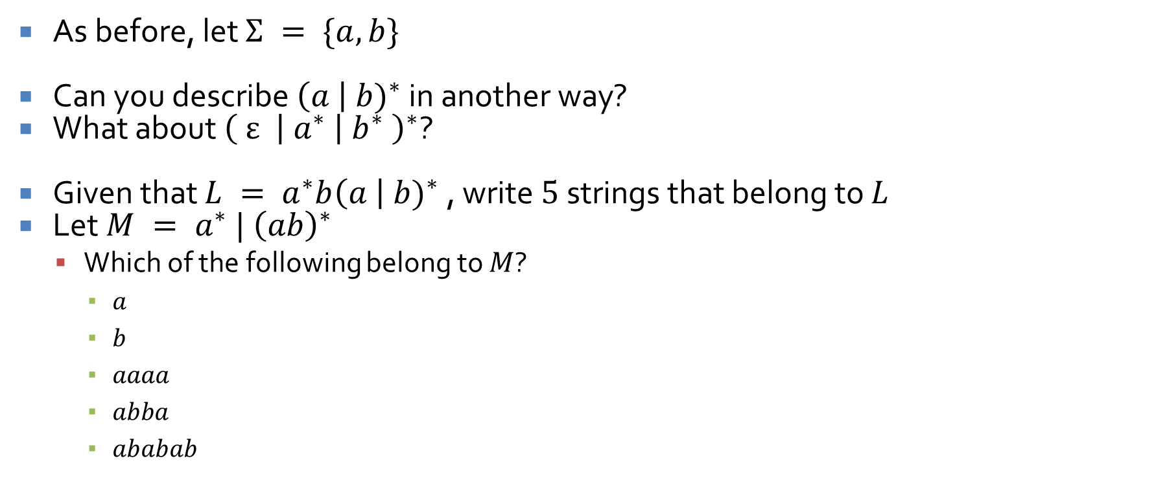
Equivalences
As before, let $Σ = \{a, b\}$
Can you describe ${\left(a \right| b)}^{∗}$ in another way?
What about $\left( ε \right| a^{∗} {\left| b^{∗} \right)}^{∗}$?
Given that $L = a^{∗}b{\left(a \right| b)}^{∗}$, write $5$ strings that belong to $L$
Let $M = a^{∗} | {\left(ab\right)}^{∗}$
  Which of the following belong to $M$?
    $a$
    $b$
    $aaaa$
    $abba$
    $ababab$

Slide 16
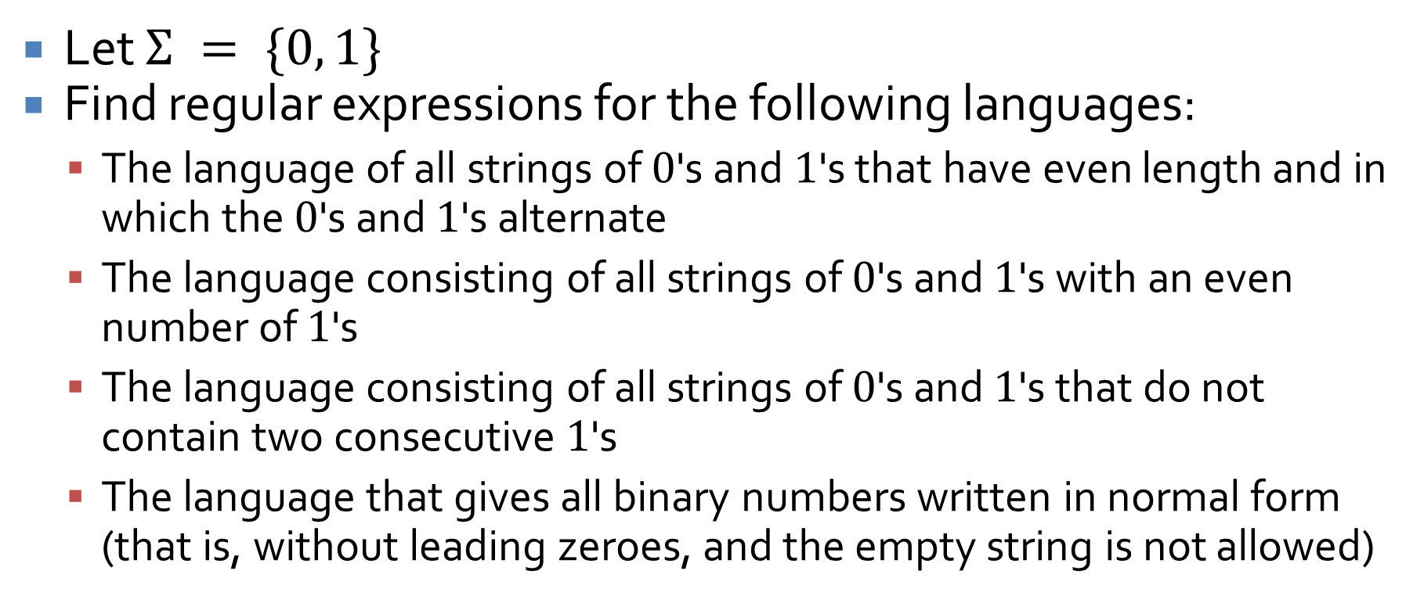
Examples
Let $Σ = \{0, 1\}$
Find regular expressions for the following languages:
  The language of all strings of $0$'s and $1$'s that have even length and in which the $0$'s and $1$'s alternate
  The language consisting of all strings of $0$'s and $1$'s with an even number of $1$'s
  The language consisting of all strings of $0$'s and $1$'s that do not contain two consecutive $1$'s
  The language that gives all binary numbers written in normal form (that is, without leading zeroes, and the empty string is not allowed)

Slide 17
Upcoming

Slide 18
Next time…
Finite-state automata

Slide 19
Reminders
Keep working on Assignment 6
Read 12.2 for Wednesday
  Prepare a three-sentence summary
  Extra credit if you get called on

